Slide 1
Exploration and Inference in the Microbiome
Kris Sankaran
Stanford University
Sabatti Lab Meeting
December 14, 2017

Slide 2
Microbiome Studies
Microbiome: All the bacteria living together in some place (e.g., human gut)
Typical goal: Characterize variation in microbiome profiles across conditions
Lies at the intersection of several sciences
Ecology + Medicine: Bacterial communities can have medical implications
Evolution + Microbiology: A data-rich setting for studying evolutionary principles
Enabled by advances in sequencing technology

Slide 3
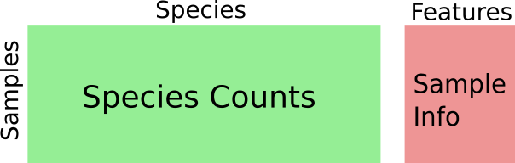
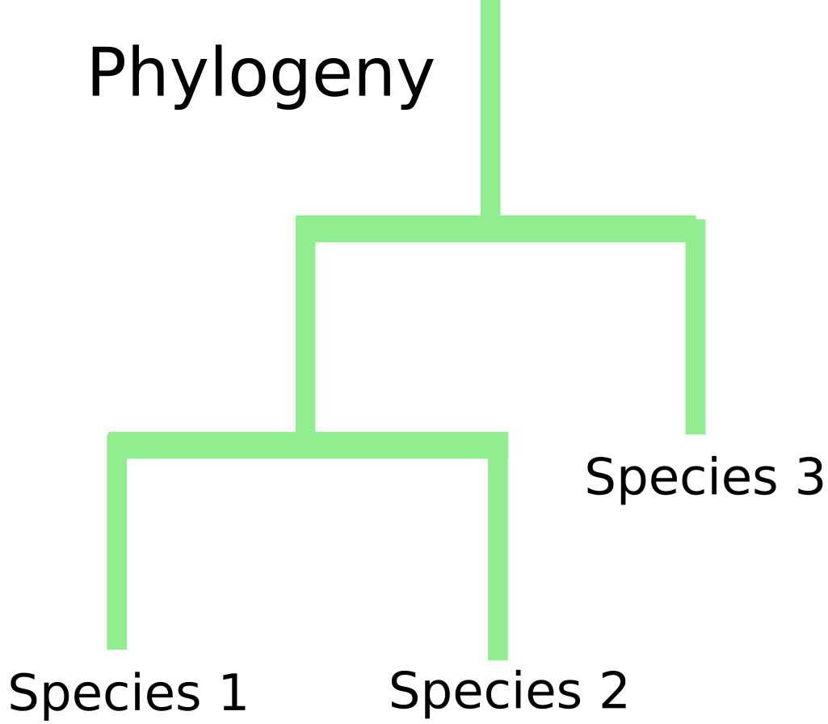
Data Sources
Sequencing of the 16S marker gene gives counts of different sequence variants, across samples
Typically 10 - 1000 samples, 500 - 2000 bacteria
Outside of bacterial counts, contextual data are available both about bacteria (taxonomic information) and samples (subject characteristics)

Slide 4
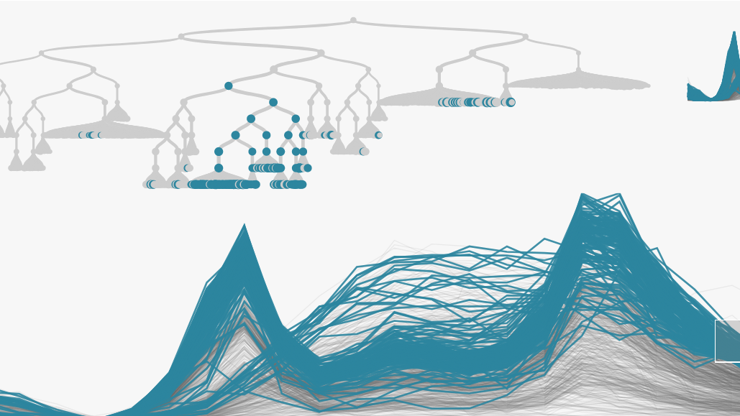
treelapse = trees + timelapse
Visualizing Hierarchies of Time Series

Slide 5
Motivating Statistical Problems
(Tree-structured) Differential Abundance
Compare bacterial abundances across conditions, with emphasis on middling taxonomic orders
Identify the largest taxonomic subtree whose associated bacteria are differentially abundant
(Tree-structured) Differential Dynamics
Describe changes in bacterial abundances, at the highest subtree where the pattern appears
Has an ecological flavor, with emphases on role of niches and environmental changes

Slide 6

Visualization Principles: Focus and Context
It is often possible to study the same data at multiple scales
Full network vs. neighborhood of a node
Full time series vs. short time window
These scales can be juxtaposed by focusing on a few elements of interest while retaining context
Interactivity can allow rapid transitions between alternative scales

Slide 7
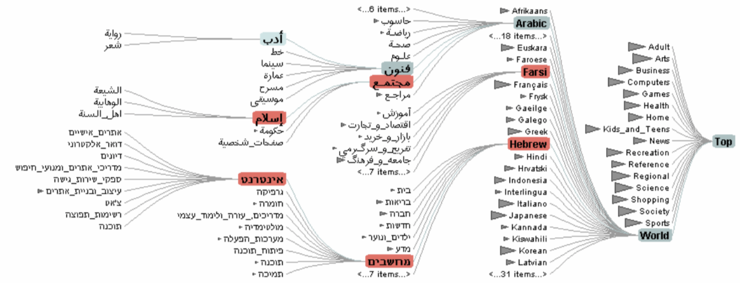
Degree-of-Interest (DOI) Trees
An application of the focus + context idea to tree structured data
Easily navigate the tree across different scales (e.g., species vs. Phylum)

Slide 8
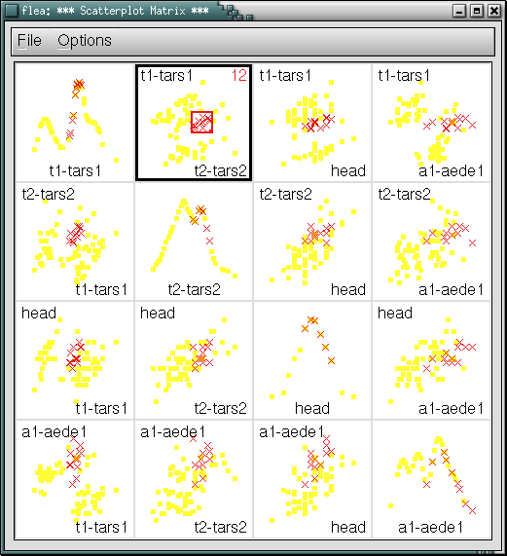
Visualization Principles: Linking
Alternative representations of the same samples can be placed side-by-side to suggest covariation [Becker and Cleveland 1987, Buja et. al. 1996]
Can be useful for studying more than two dimensions at a time
Conditional probability and database query interpretations
What are values other variables, conditional on constraints for some of them
Linked scatterplot brushing, as implemented in GGobi [Voigt 2002].

Slide 9
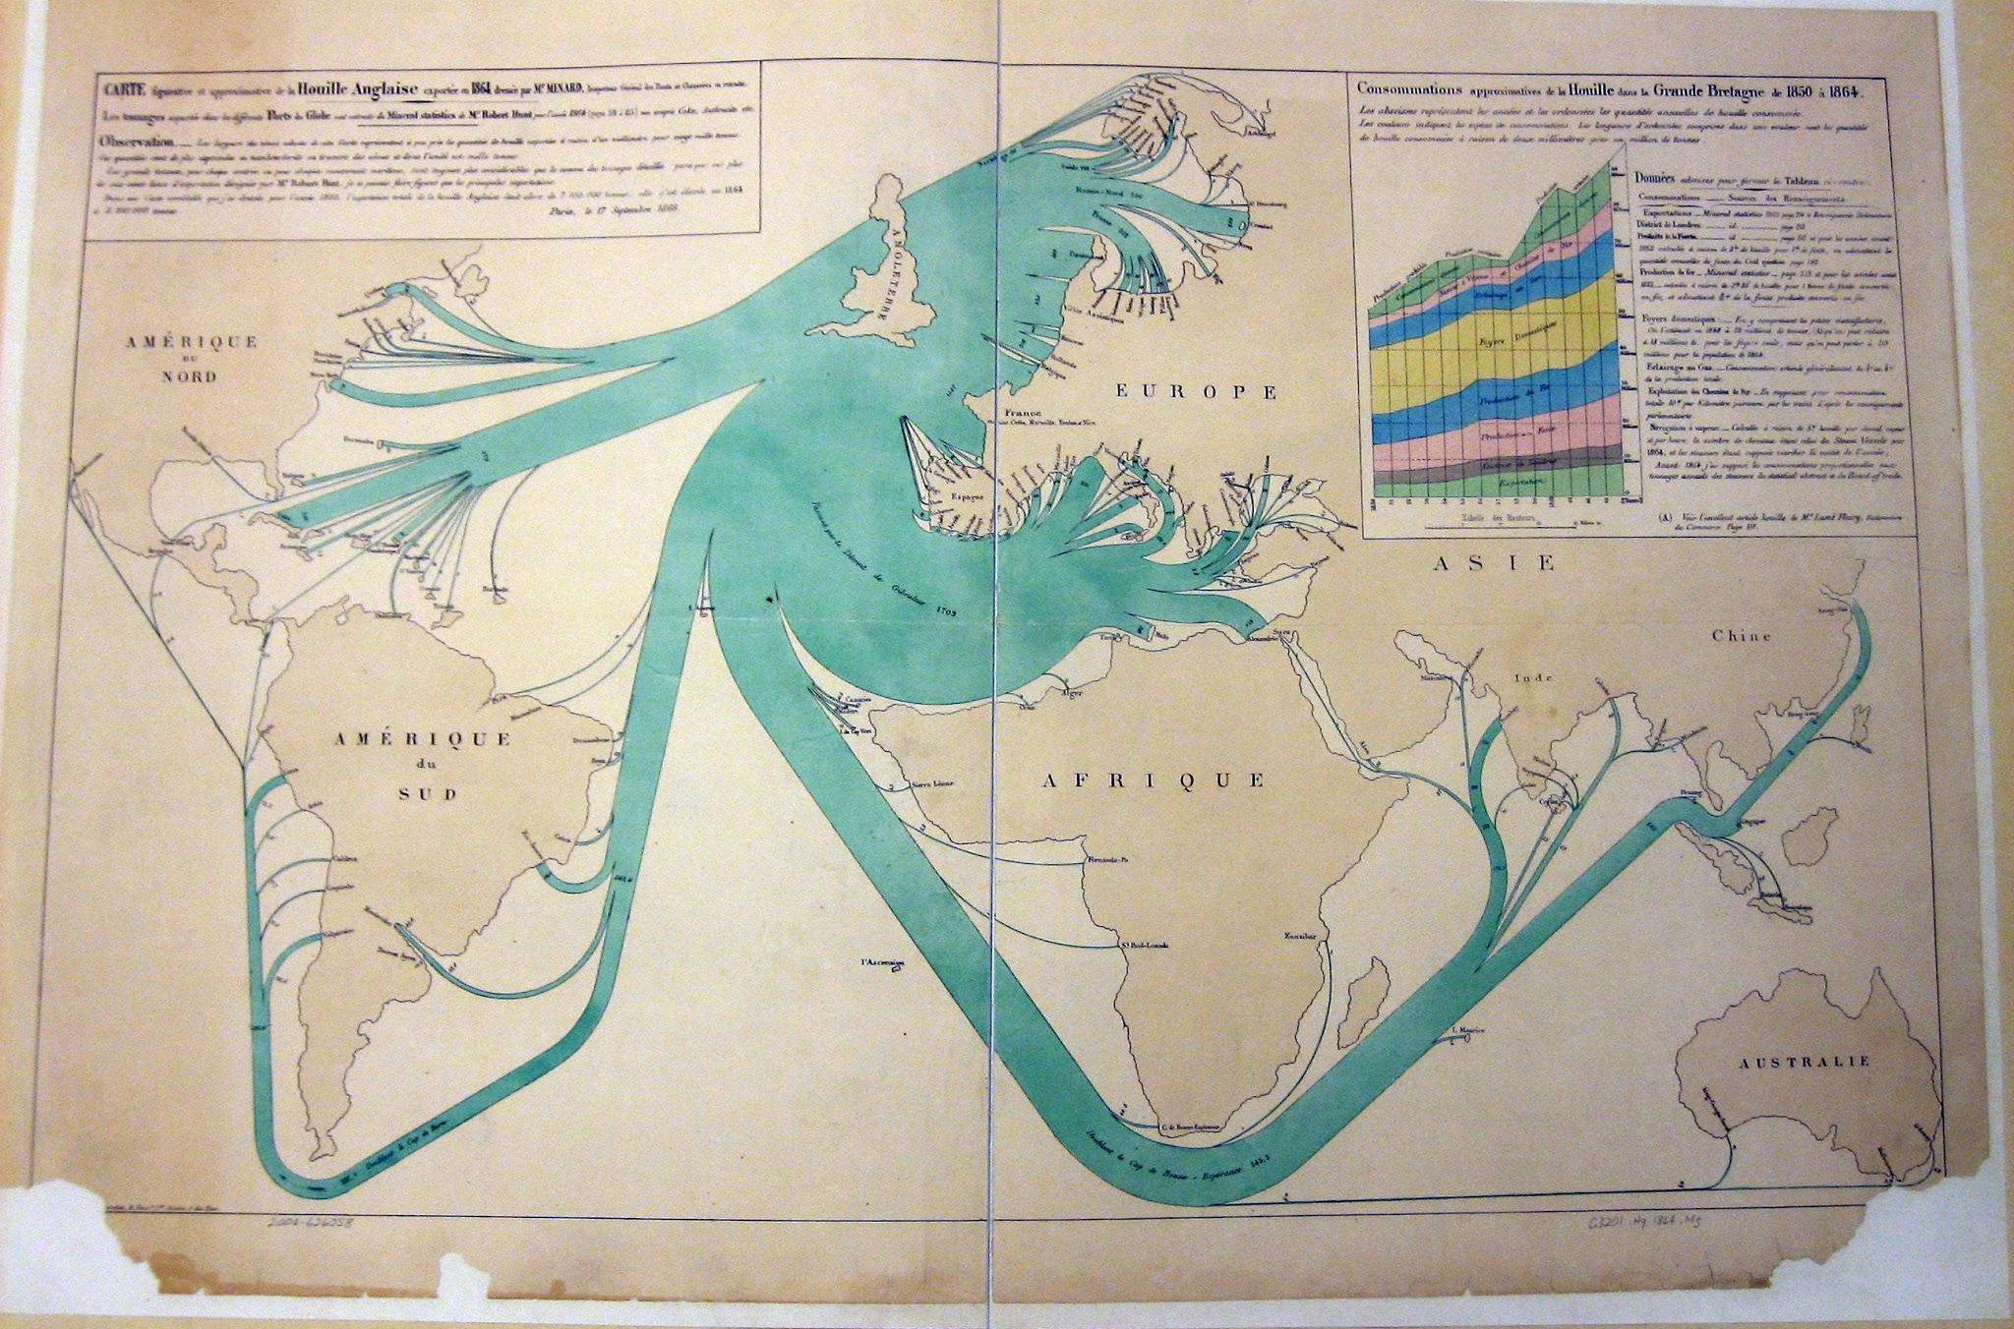
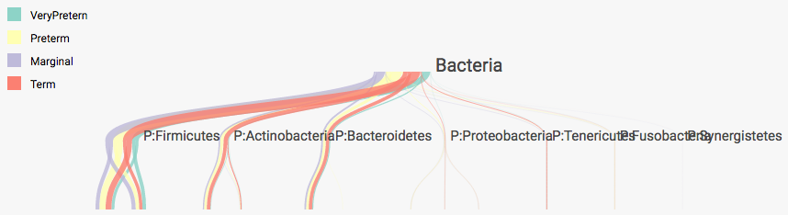
Visualization Proposals
Differential Abundance
DOI Tree: Standard DOI implementation, slightly extended to show node abundances
DOI Sankey: Modify DOI Trees to multiple groups, which are distinguished by color
A sankey diagram of British coal exports, made in 1868 by Charles Joseph Minard.
An example DOI Sankey, applied to a microbiome taxonomy.

Slide 10
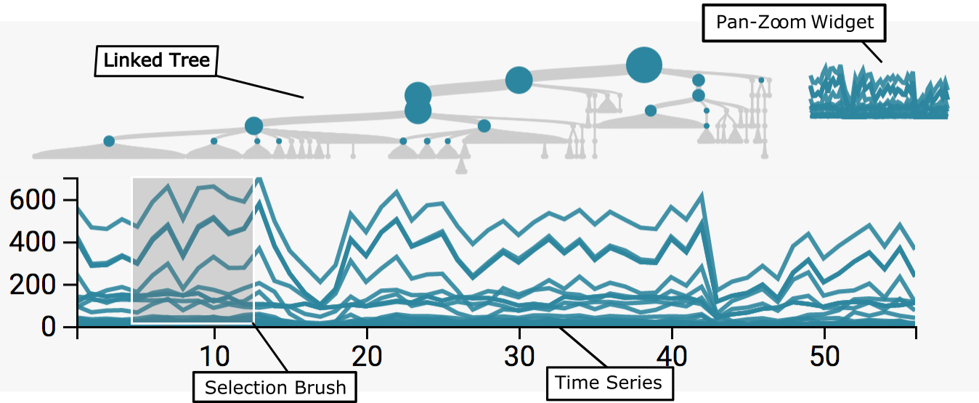
Visualization Proposals
Differential Dynamics
Timebox Trees: Link timeboxes and tree, with selections over time series
Treeboxes: Link timeboxes and tree, with selections over the tree

Slide 11
Bacterial Dynamics and Antibiotic Time Courses
Revisiting the study [Dethlefsen and Relman, 2011]
Study Goal: What is the response of the microbiome following antibiotics, in comparison to natural long-term variation? ["Flash Flood" analogy]
Data: 3 subjects, across ~ 50 timepoints, with two antibiotic time courses introduced in between
We study one subject at a time, and filter away less abundant microbes

Slide 12
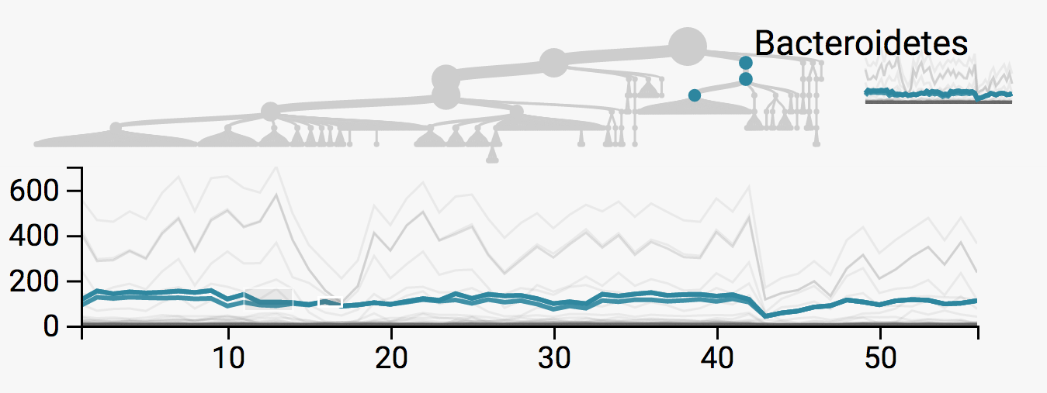
Bacteroidetes are unaffected
We can sketch timeboxes to identify series with no change
After some study, it becomes clear that one phylum does not seem to be strongly affected by the first antibiotic time course

Slide 13
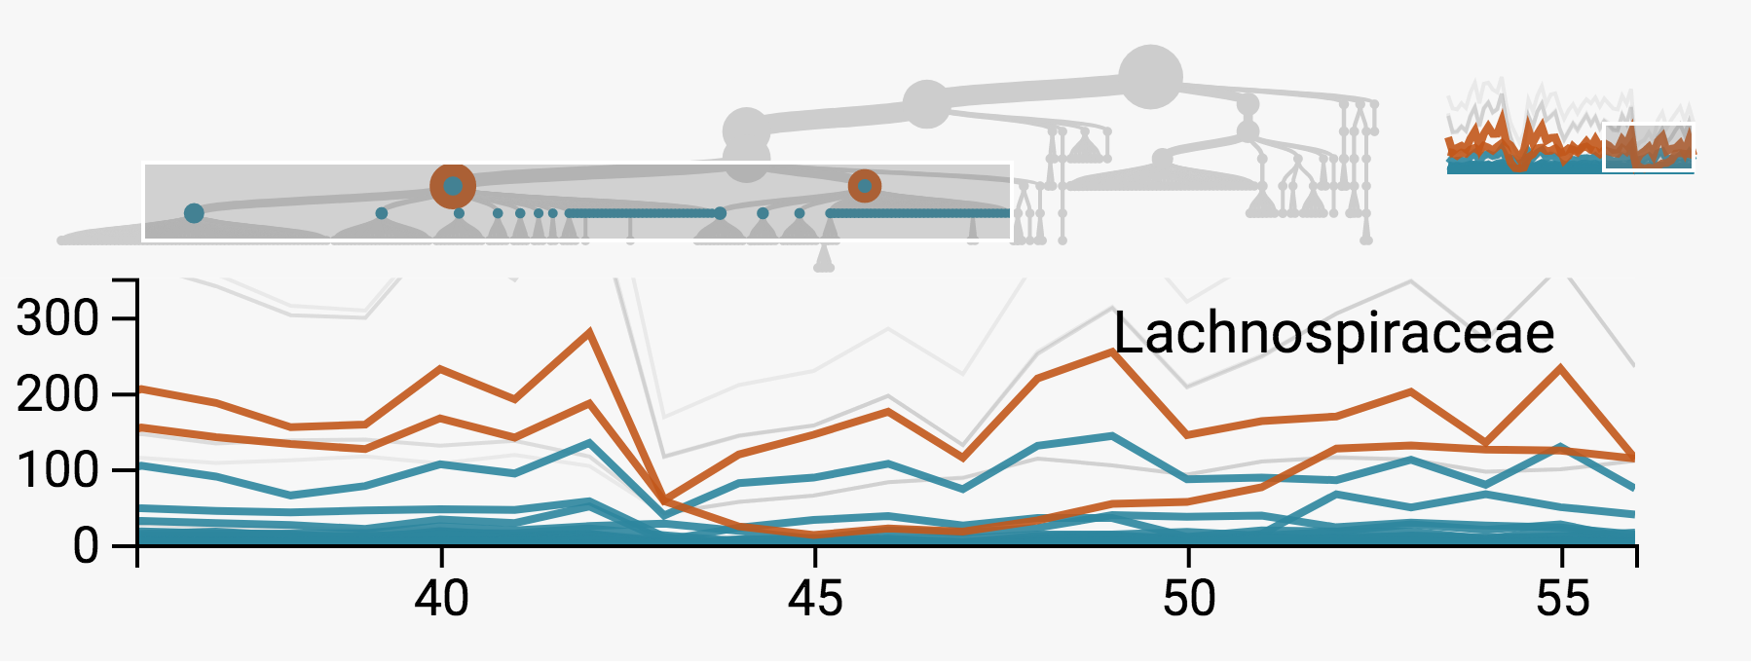
Differential Response among Firmicutes
Drawing boxes over the tree and searching for different taxonomic orders suggests differential responses between the Lachnospiraceae and Ruminococcaceae
Note that we are focusing on the time window surrounding the second antibiotic time courses

Slide 14
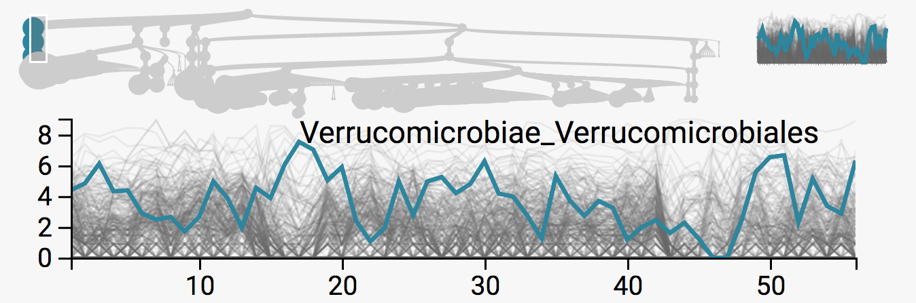
Averages vs. Sums on Tree
We have effectively only been studying sums across large taxonomic groups
To understand finer-grained taxa, we can either use the pan-zoom widget to emphasize lower scales, or consider averages up the tree instead of sums
We use the second approach to inspect recovery among Ruminococcaceae
The average abundance across the Verrumicrobiae seems to increase after the antibiotic treatment.

Slide 15
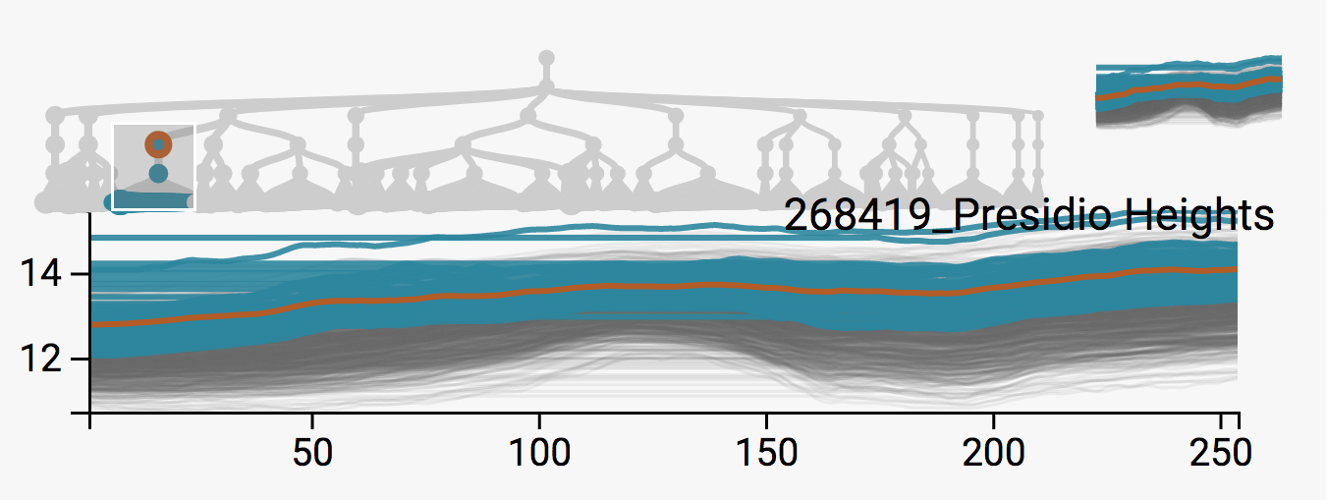
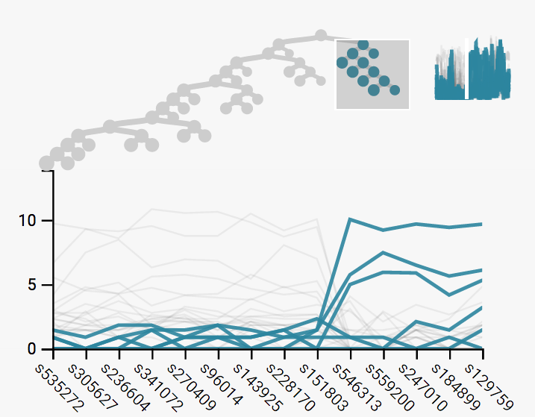
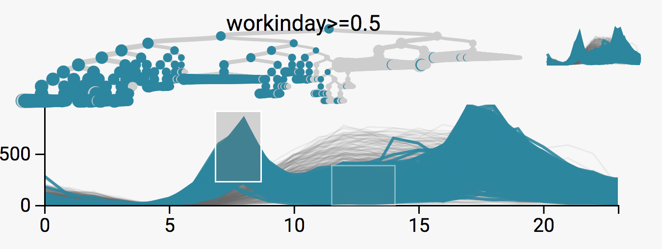
Beyond Phylogenies
Hierarchical structure is present in many contexts
Spatial Hierarchies
Hierarchical Clustering
Regression Trees

Slide 16
Multiple Testing on Trees

Slide 17
Problem and Approaches
What is an inferential approach to tree-structured differential abundance?
FDR control only applies to individual hypothesis
How to leverage the indirect evidence across the tree?
This question has motivated a few recent research directions
Testing groups of hypothesis
Hierarchical search
Isolated proposals from bioinformatics

Slide 18
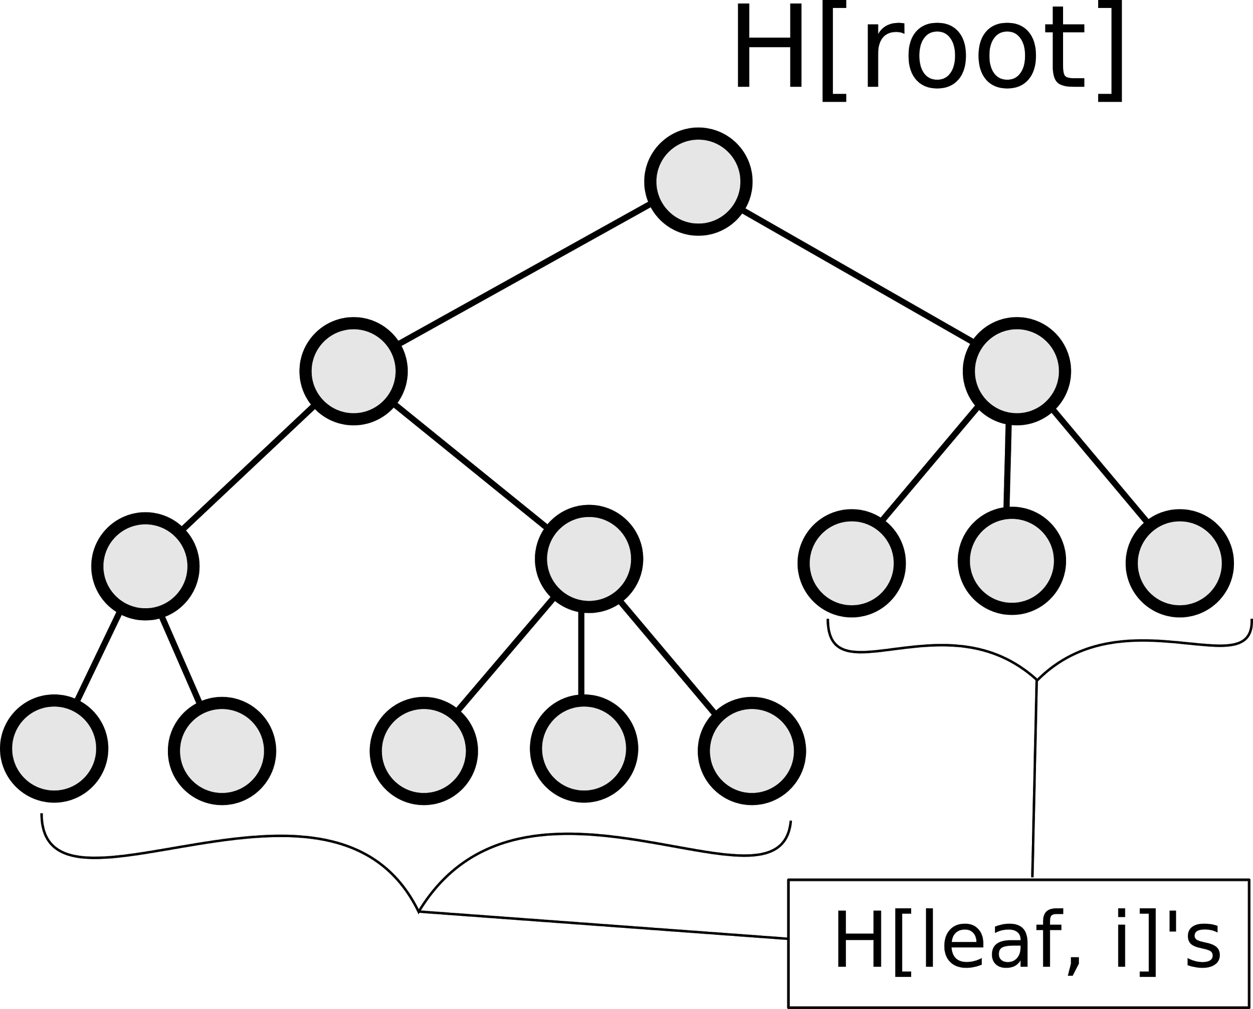
A simple algorithm and its properties
A proposal of Yekutieli [2008] is to proceed top down through a hierarchy, using an FDR controlling procedure between sibling nodes.

Slide 19
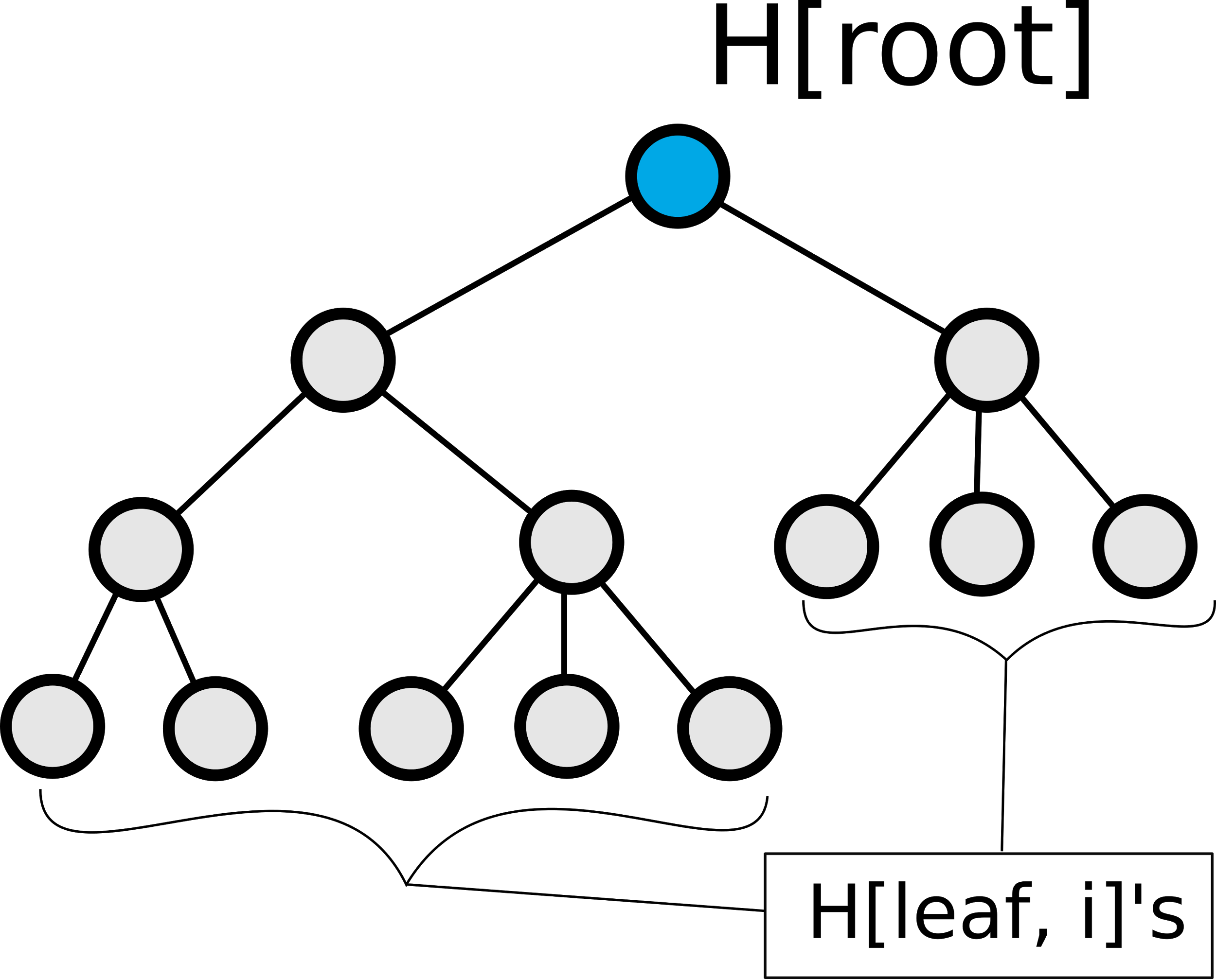
A simple algorithm and its properties
A proposal of Yekutieli [2008] is to proceed top down through a hierarchy, using an FDR controlling procedure between sibling nodes.
First, test the root. If this fails to reject, stop the entire hypothesis testing procedure.

Slide 20
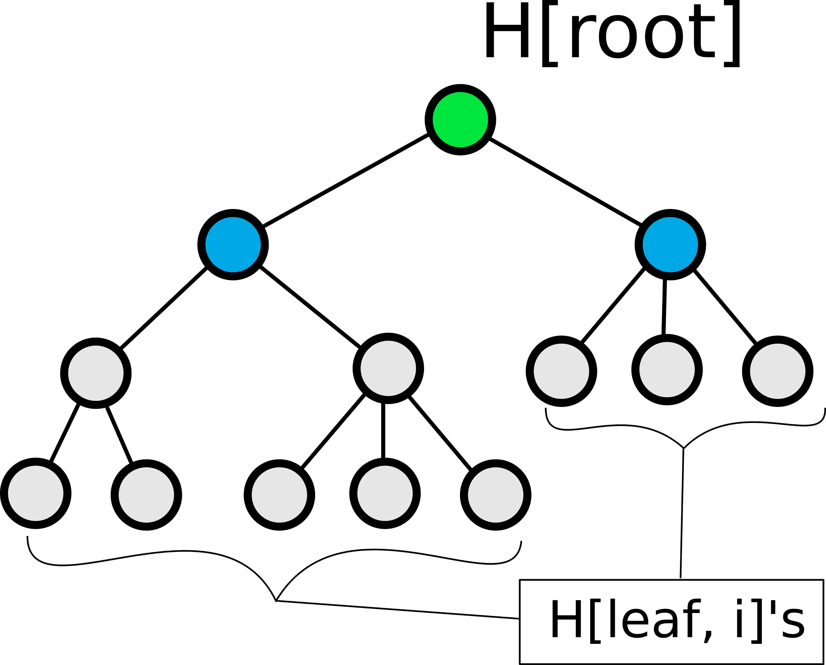
A simple algorithm and its properties
A proposal of Yekutieli [2008] is to proceed top down through a hierarchy, using an FDR controlling procedure between sibling nodes.
First, test the root. If this fails to reject, stop the entire hypothesis testing procedure.
If it rejects, test the children hypothesis and apply familywise error control.

Slide 21
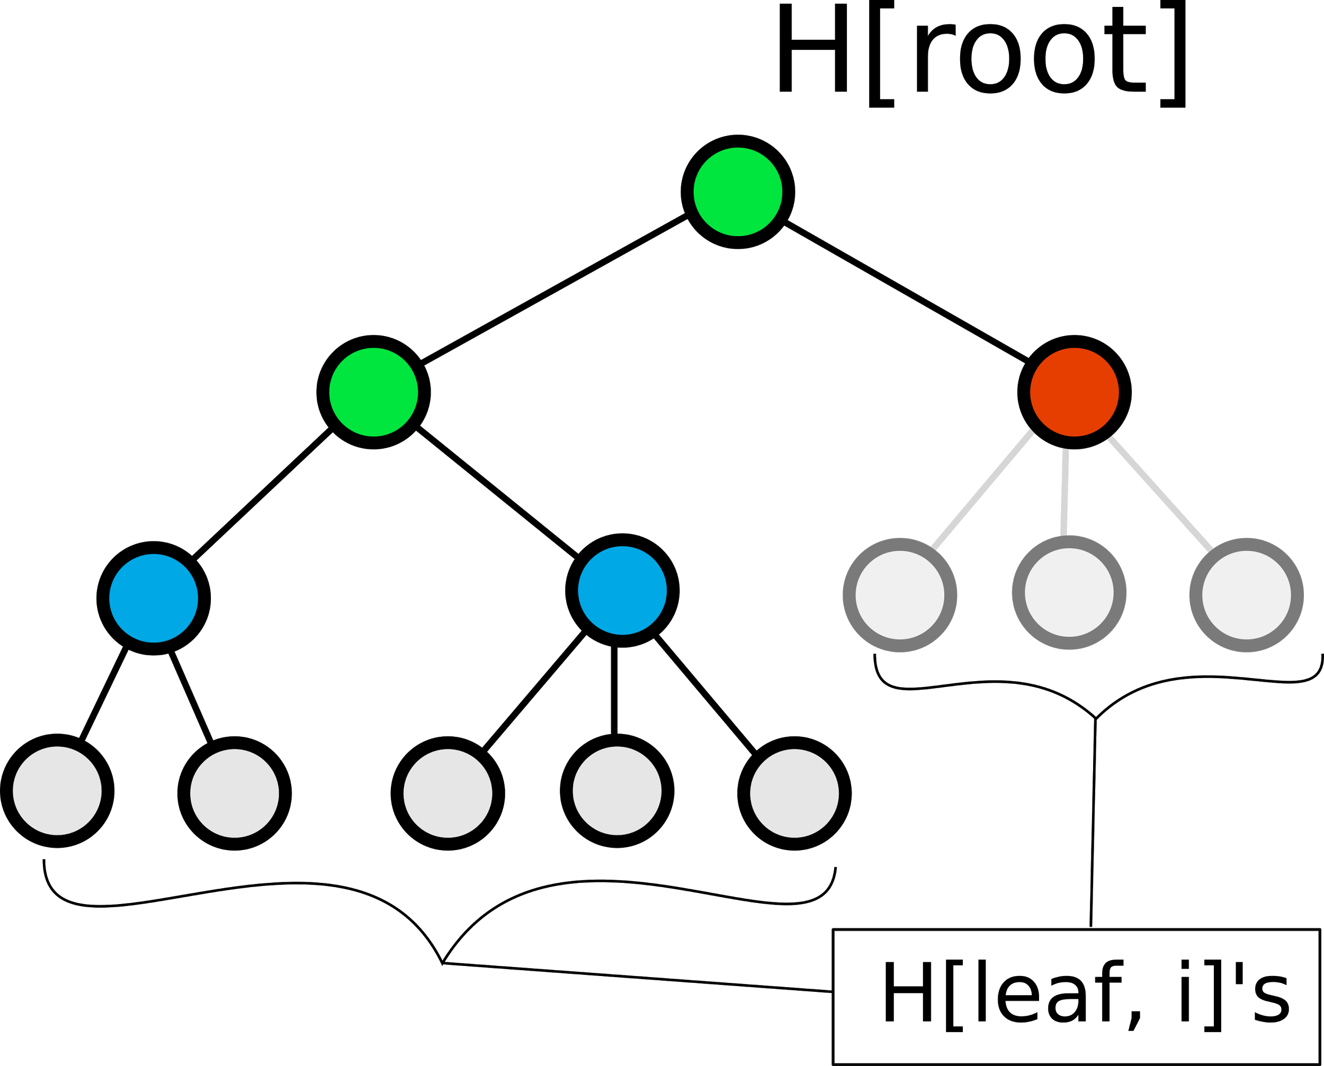
A simple algorithm and its properties
A proposal of Yekutieli [2008] is to proceed top down through a hierarchy, using an FDR controlling procedure between sibling nodes.
First, test the root. If this fails to reject, stop the entire hypothesis testing procedure.
If it rejects, test the children hypothesis and apply familywise error control.
If it fails to reject, don’t test any of the descendant hypothesis

Slide 22
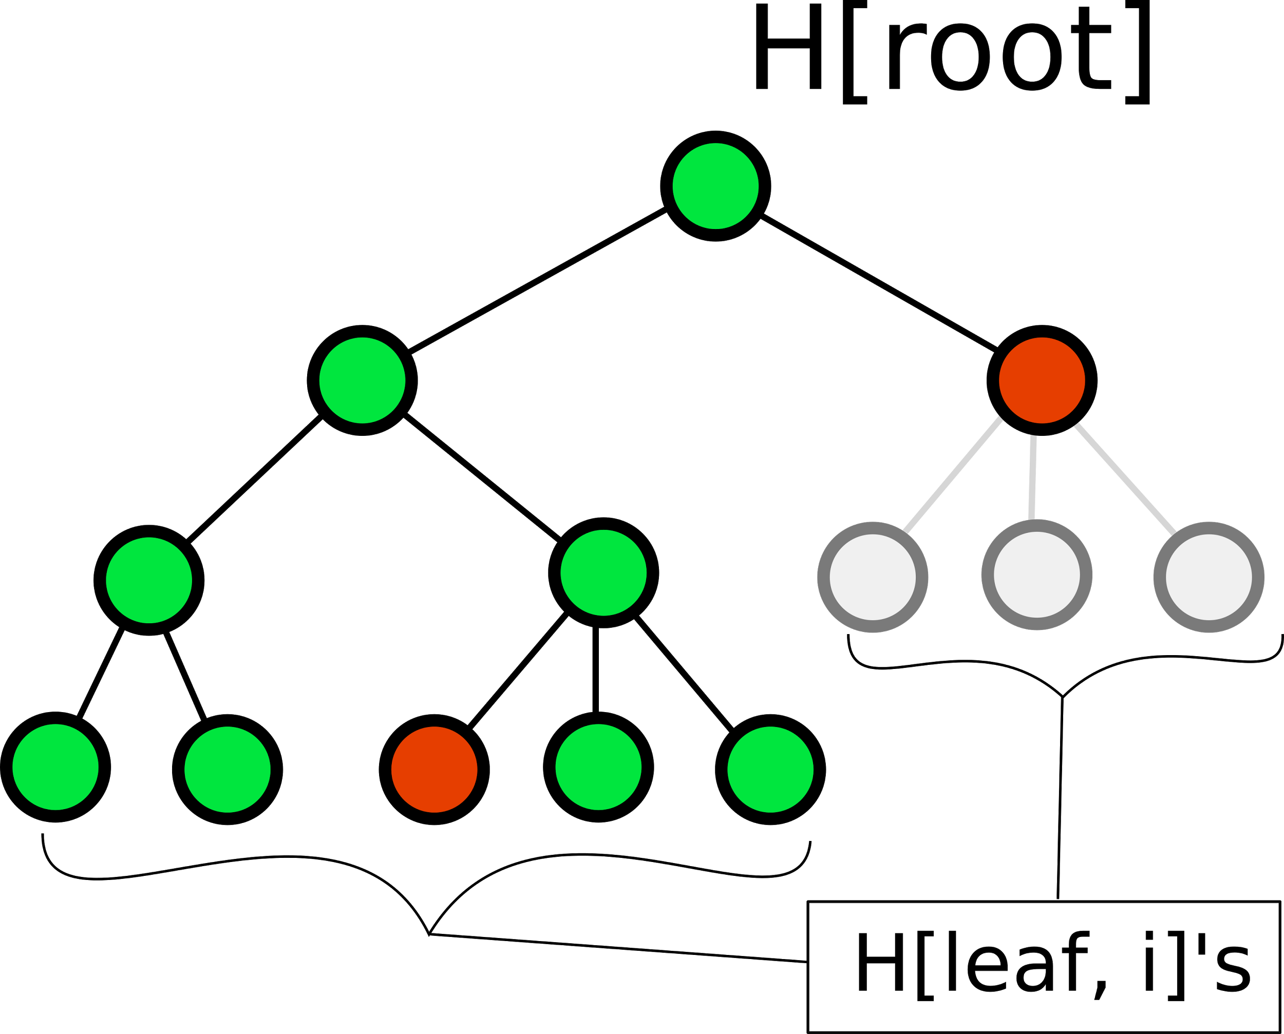
A simple algorithm and its properties
A proposal of Yekutieli [2008] is to proceed top down through a hierarchy, using an FDR controlling procedure between sibling nodes.
First, test the root. If this fails to reject, stop the entire hypothesis testing procedure.
If it rejects, test the children hypothesis and apply familywise error control.
If it fails to reject, don’t test any of the descendant hypothesis
Continue testing in this fashion down to the leaves

Slide 23
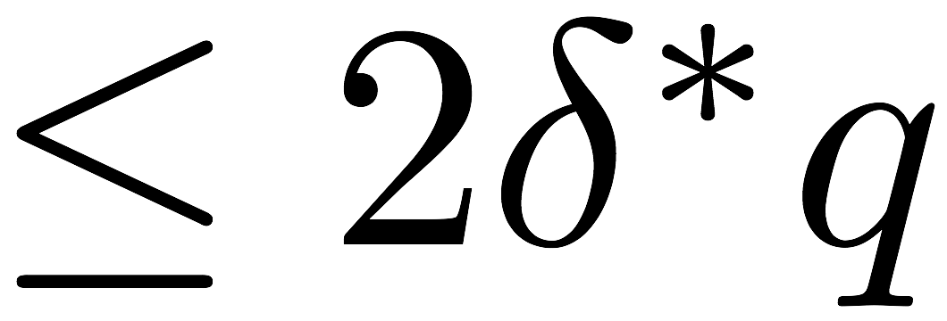
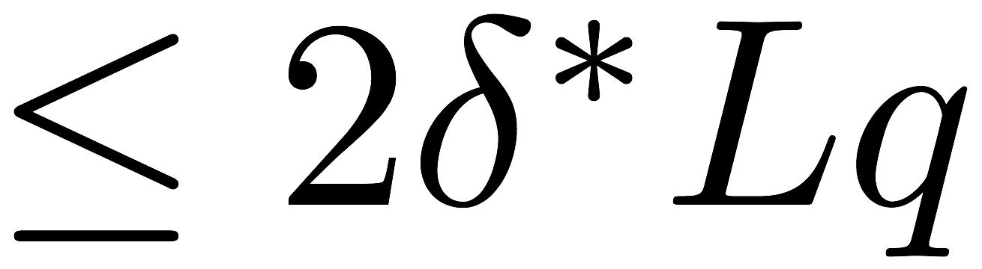
A simple algorithm and its properties
A proposal of Yekutieli [2008] is to proceed top down through a hierarchy, using an FDR controlling procedure between sibling nodes.
This procedure was shown to guarantee different types of false discovery rates
Tree FDR
Level-L FDR

Slide 24
Implementation
We designed and implemented the structSSI (structured simultaneous and selective inference) R package, implementing this procedure and a group testing procedure [Hu et. al. 2010]
Includes utilities for,
Computing statistics along tree
Visualization of results along the tree

Slide 25
Developments

Slide 26
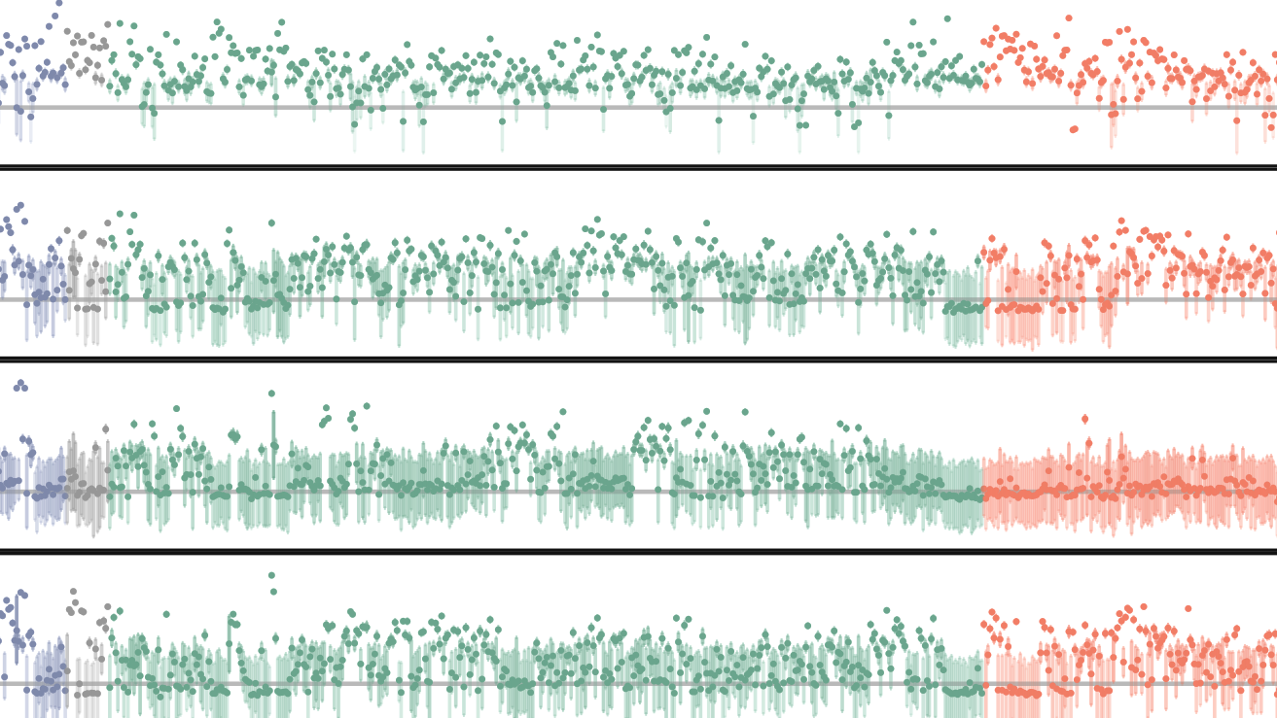
Probabilistic Latent Variable Modeling
for the Microbiome

Slide 27
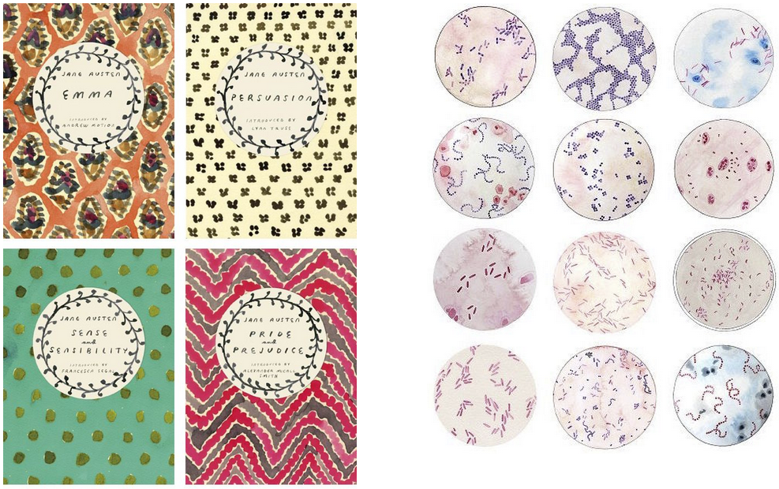
Motivating Idea
Schloss and Handelsmen [2007] noted the parallels between text and microbiome data
Yet, the application of text models in the microbiome literature is limited
Probabilities models in particular are useful in studies with complex structure
Contribution: In the spirit of [Callahan 2016, Fukuyama 2017], describe a workflow, provide code, and compare existing methods, focusing on interpretation, usability, and visualization

Slide 28
Microbiome vs. Text Analysis
The left table gives word counts for a few words, across a few paragraphs in Pride and Prejudice
The right table are microbiome abundances for a few species, at a few timepoints in the antibiotics data
The analogy is natural, though the actual problem structure can be quite different
index | book | eliza. | darcy | bennet | miss | jane
0 | P&P | 0 | 0 | 4 | 0 | 1
1 | P&P | 1 | 0 | 5 | 0 | 1
2 | P&P | 0 | 0 | 6 | 0 | 0
3 | P&P | 1 | 4 | 5 | 1 | 0
4 | P&P | 3 | 3 | 5 | 4 | 4
time | subject | sp_1 | sp_2 | sp_3 | sp_4 | sp_5
0 | D | 791 | 0 | 79 | 108 | 11
1 | D | 1616 | 0 | 1413 | 192 | 31
2 | D | 1323 | 0 | 915 | 165 | 23
3 | D | 1846 | 0 | 1366 | 170 | 31
4 | D | 2314 | 0 | 689 | 135 | 26

Slide 29
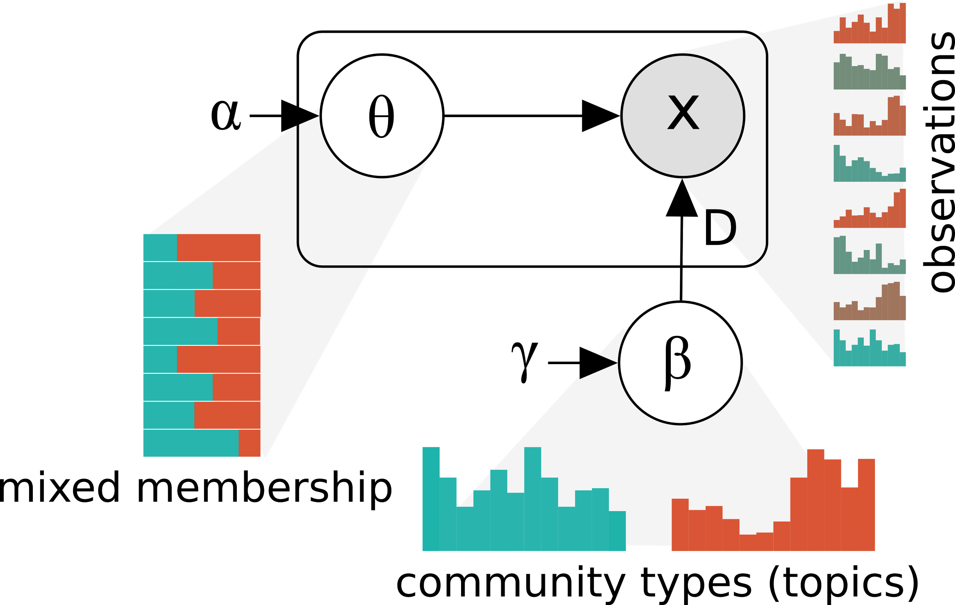
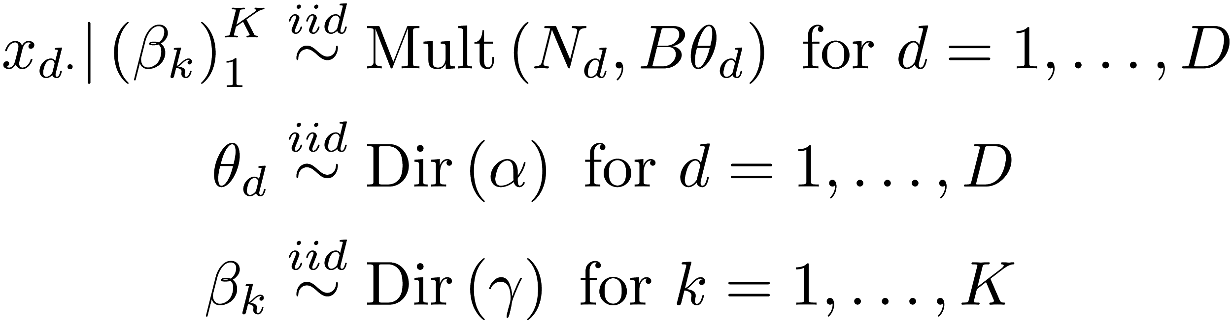
Models Considered: Latent Dirichlet Allocation
Latent Dirichlet Allocation (LDA) is an alternative to Multinomial Mixture Modeling that assumes that samples have mixed memberships across topics [Pritchard et. al 2000, Blei et. al. 2003]
Posterior inference can be done with Variational Approximations or (collapsed) Gibbs
We think of microbiome communities as mixtures of underlying community types

Slide 30
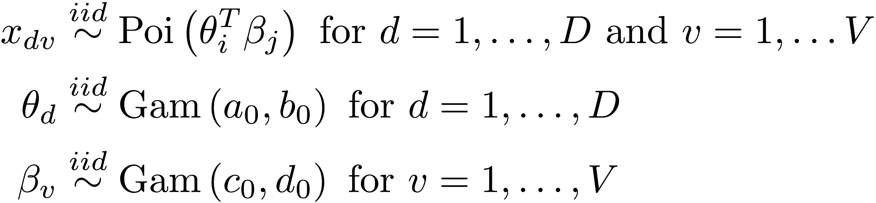
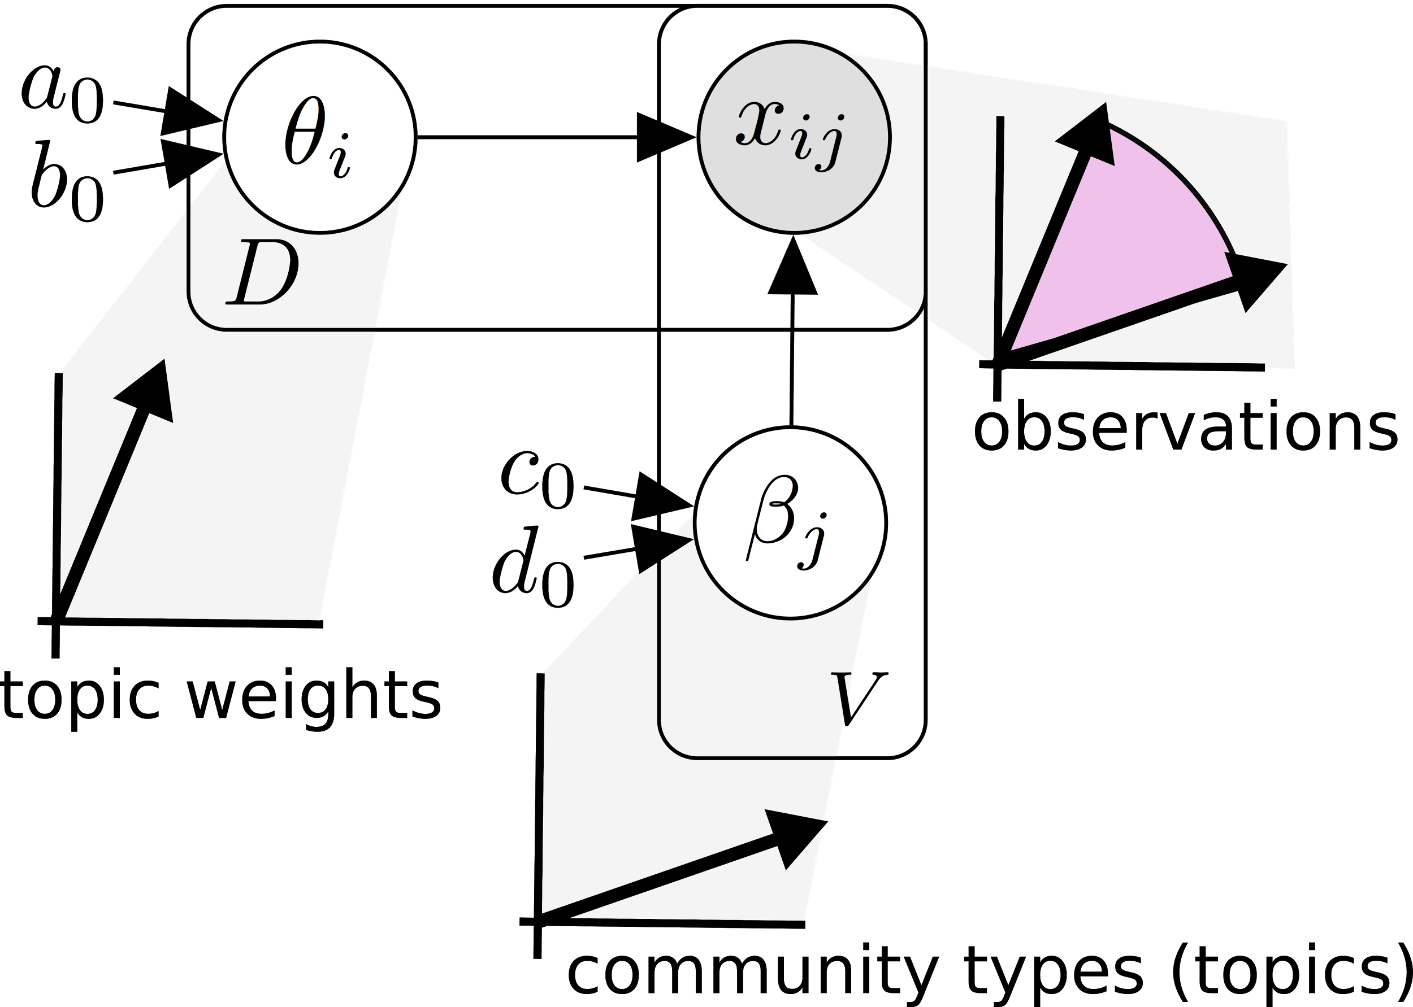
Models Considered: Gamma-Poisson Factorization
Nonnegative Matrix Factorization can be implemented with a low-rank Gamma-Poisson model [Canny 2004]
Mixture and topic vectors are no longer required to sum to one
The average size of an entry is set by the angle between associated mixture and topic vectors

Slide 31
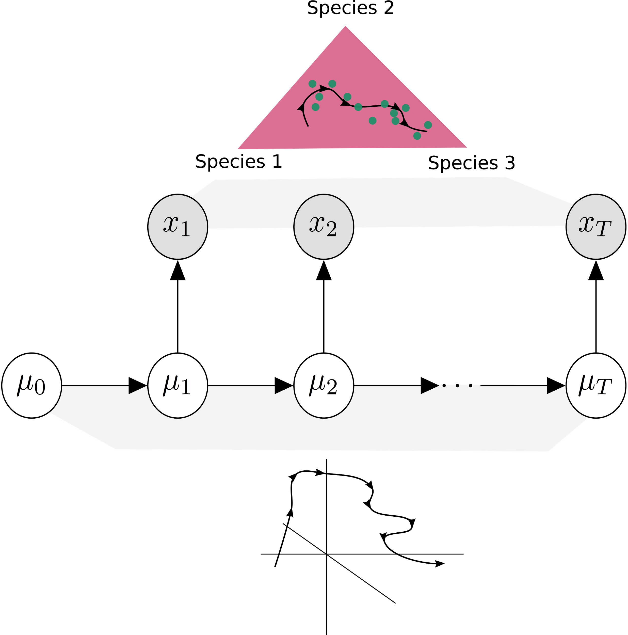
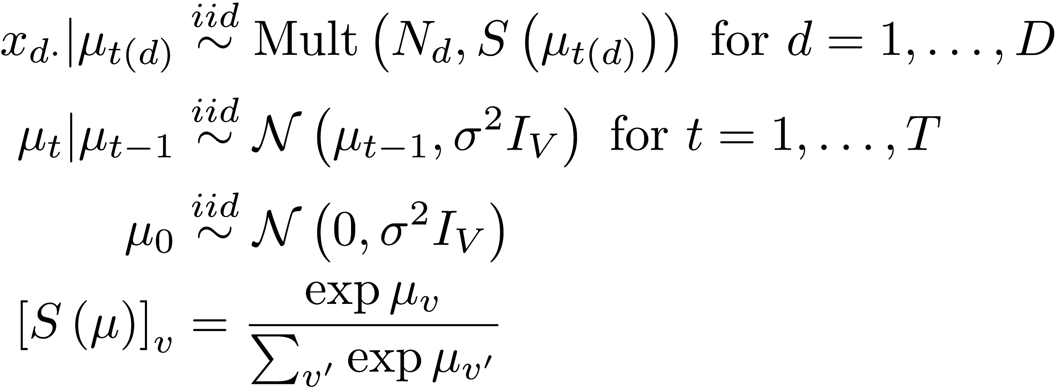
Models Considered: Dynamic Unigrams
The Dynamic Unigram Model supposes the distribution of species within a sample evolves smoothly over time
This is accomplished by passing a Gaussian random walk through a multilogit link
The factorized version is the Dynamic Topic Model [Blei and Lafferty 2006]

Slide 32
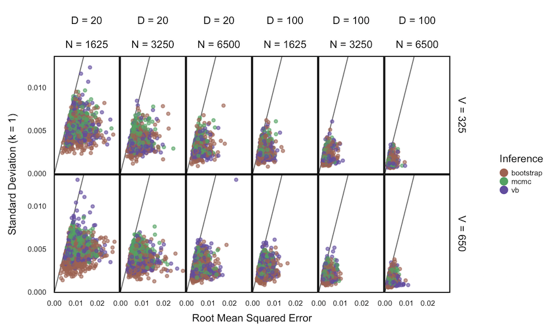
Simulation Study
We perform a simulation study using data with dimensions comparable to those in the microbiome
D: Number of samples
V: Number of species
N: Sequencing depth
Colors are inference techniques
VB and the Bootstrap generally underestimate posterior uncertainty, but all become precise with large N

Slide 33
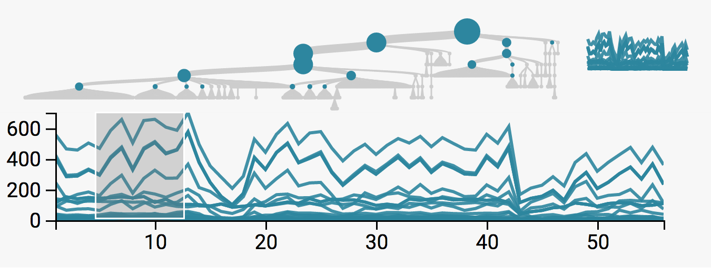
Antibiotics revisited
We apply these methods to the data of [Dethlefsen and Relman 2011], which we visualized earlier using the treelapse package
In contrast to that work, our goal here is a succinct quantitative representation of the species abundance trajectories
We focus on the LDA and Dynamic Unigram models

Slide 34
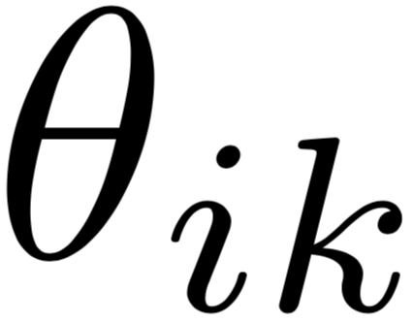
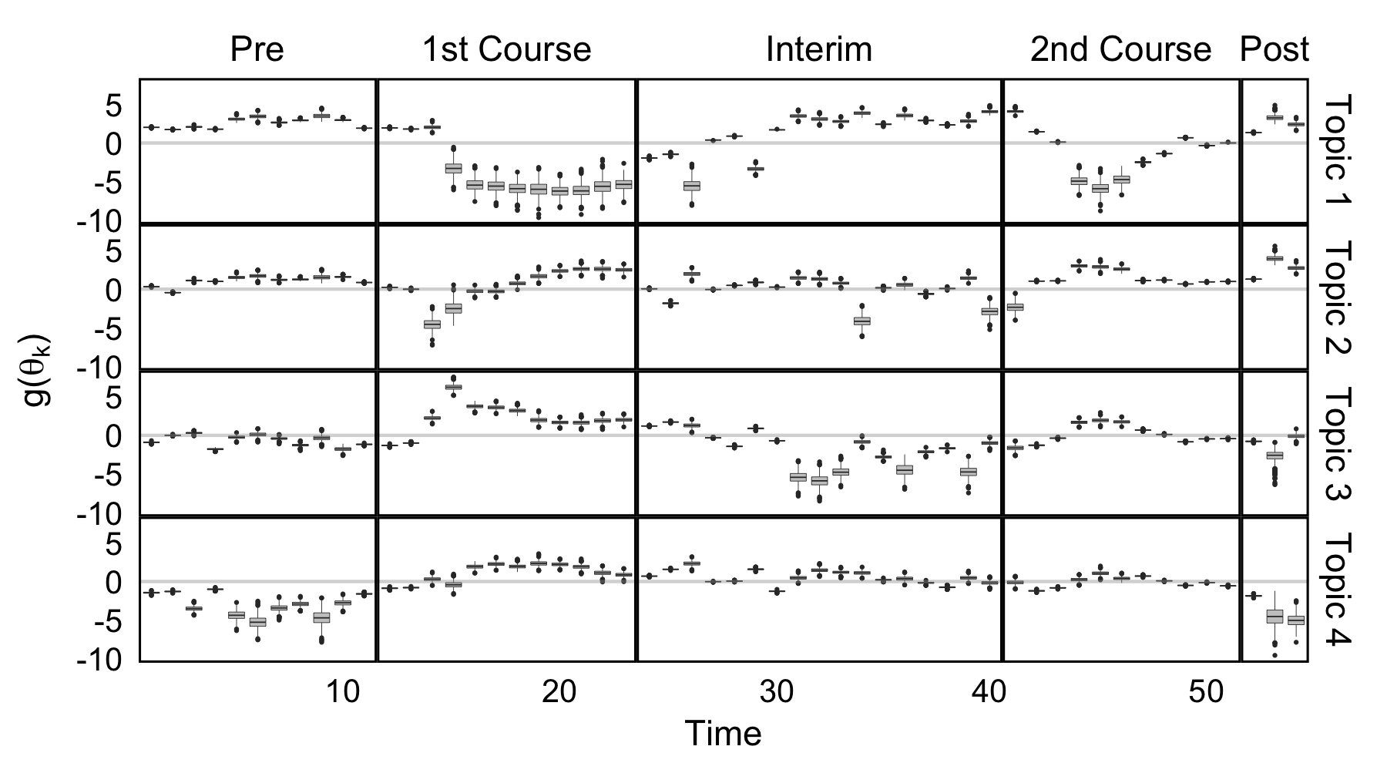
Estimated Mixed-Memberships:
Boxplots represent approximate posteriors for tes and their evolution
A centered log transform has been applied
Interpretations
Slow recovery
Fast recovery
Relatively increase
No effect

Slide 35
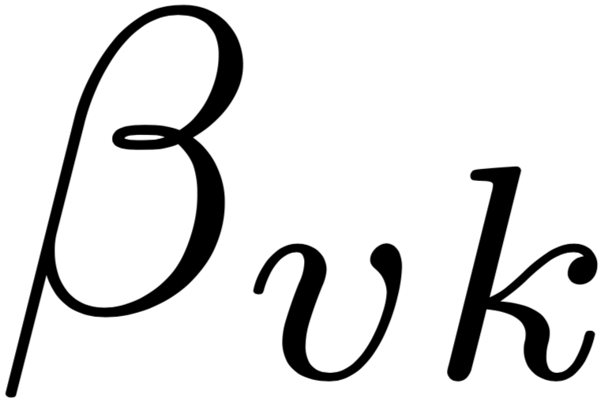
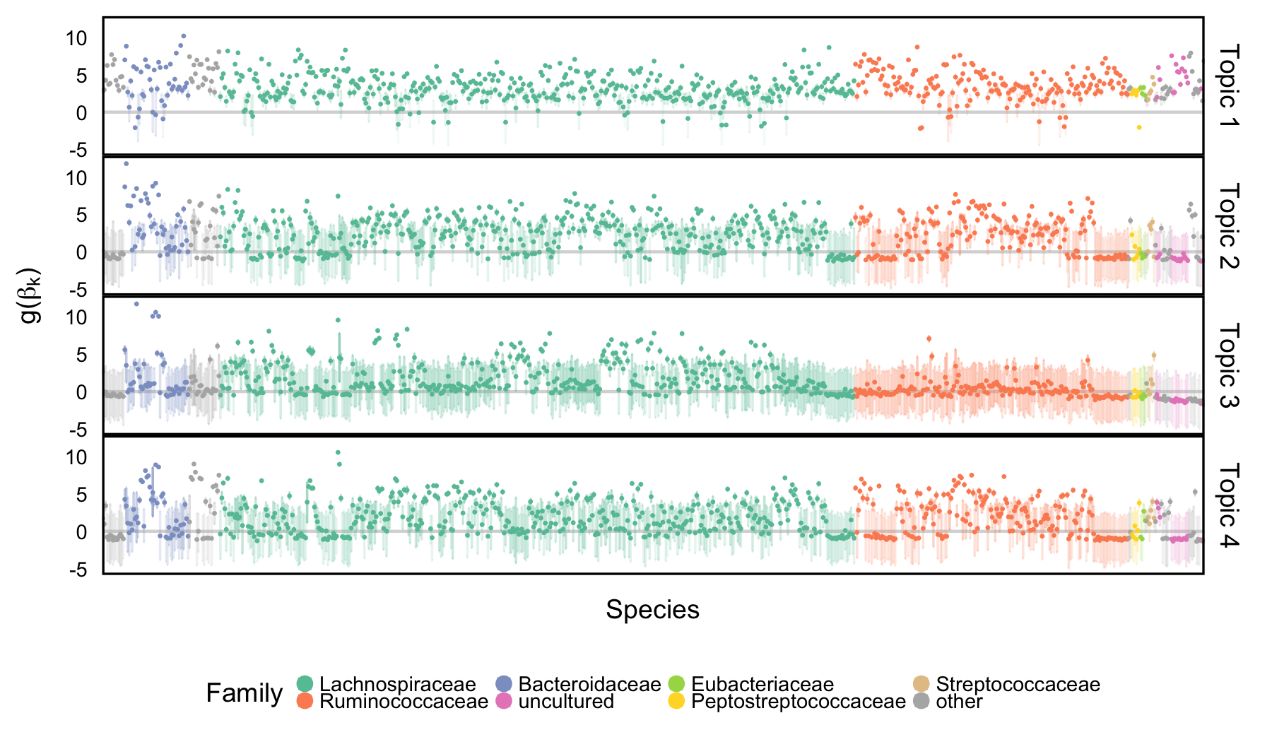
Estimated Topics:
Intervals represent approximate tes posteriors
Each row is a topic, each interval is a species, colors are taxonomic groups
A centered log transform has been applied
The third topic is noticeably less diverse, corresponding to the community during antibiotics time courses

Slide 36
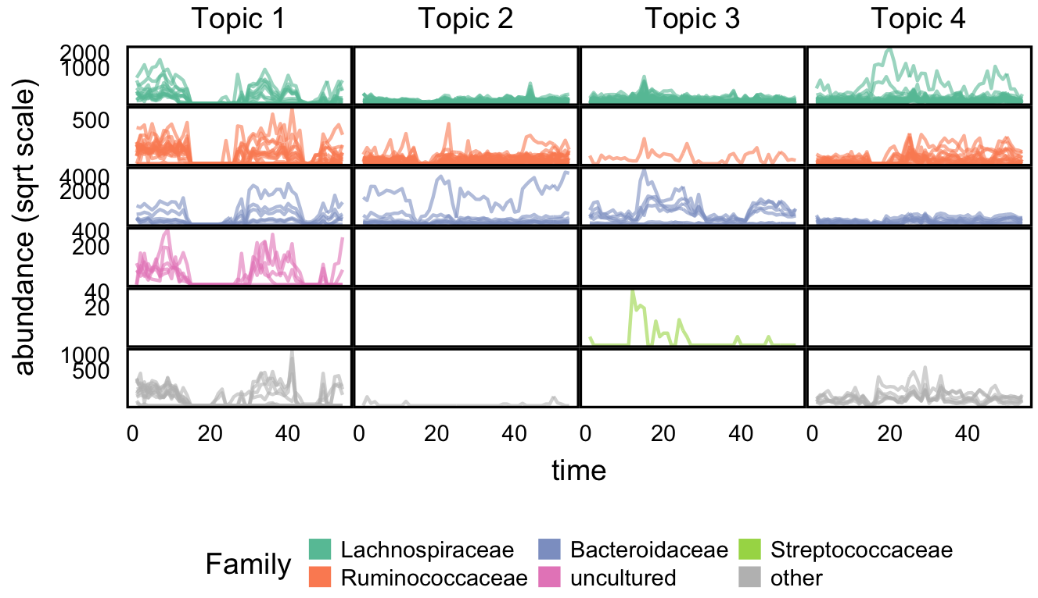
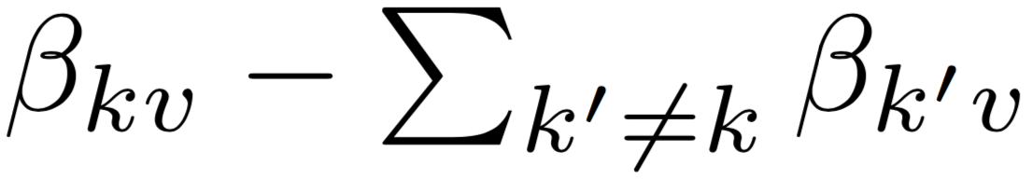
Topic Prototypes
Screened species that are represent individual topics
50 species with large
Rows are taxonomic groups, columns are topics
Each trajectory gives the abundance of a single species over time

Slide 37
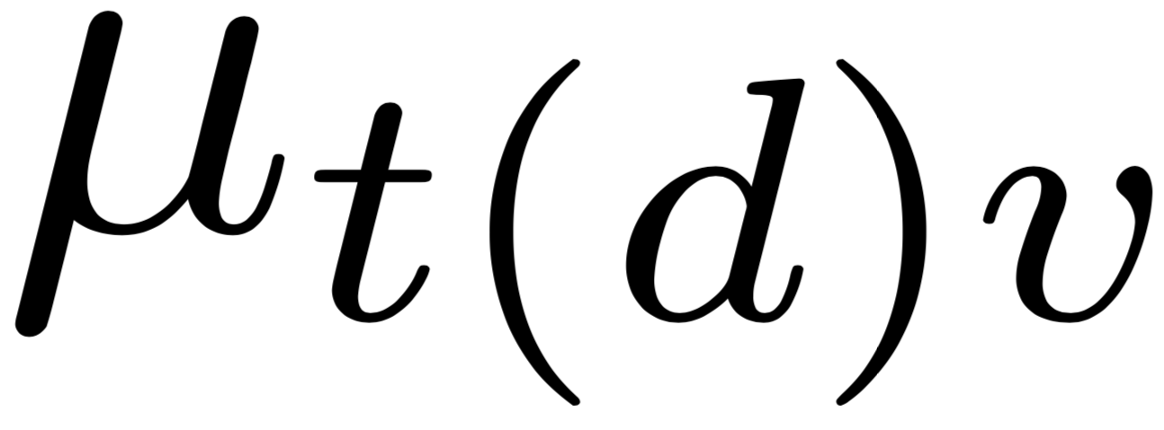
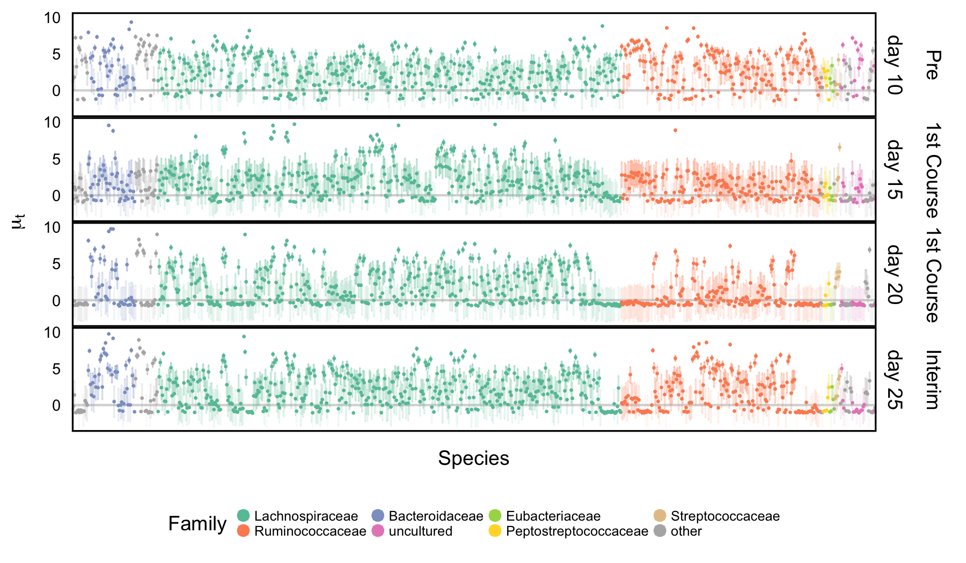
Smoothed Means:
Intervals represent approximate posteriors for the smoothed means
Each row is a timepoint, each interval is a species, colors are taxonomic groups
The third panel down is the first one where antibiotics has been applied

Slide 38
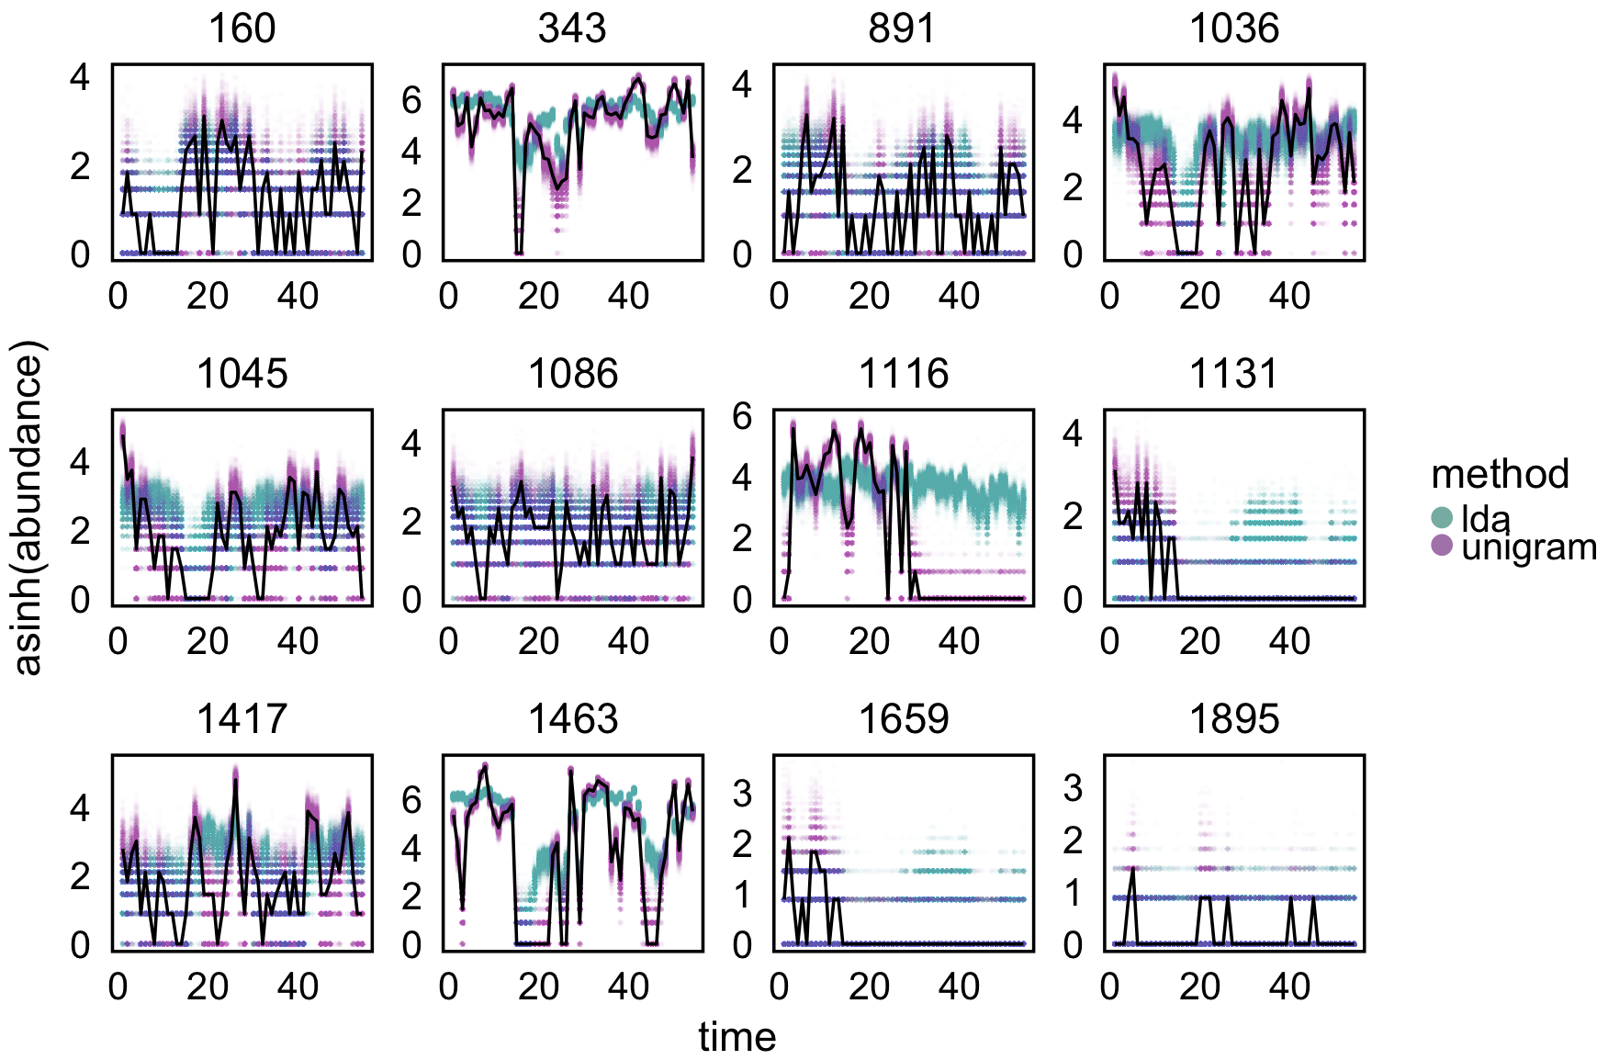
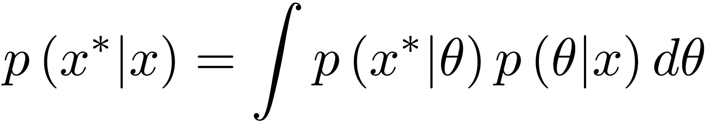
Model Criticism
We simulate data from the posterior predictive,
Each panel represents one species, the black lines are observed species trajectories
The blue and purple lines are LDA and unigram posterior predictive samples
The unigram model overfits
Species 1116 is an interesting outlier

Slide 39
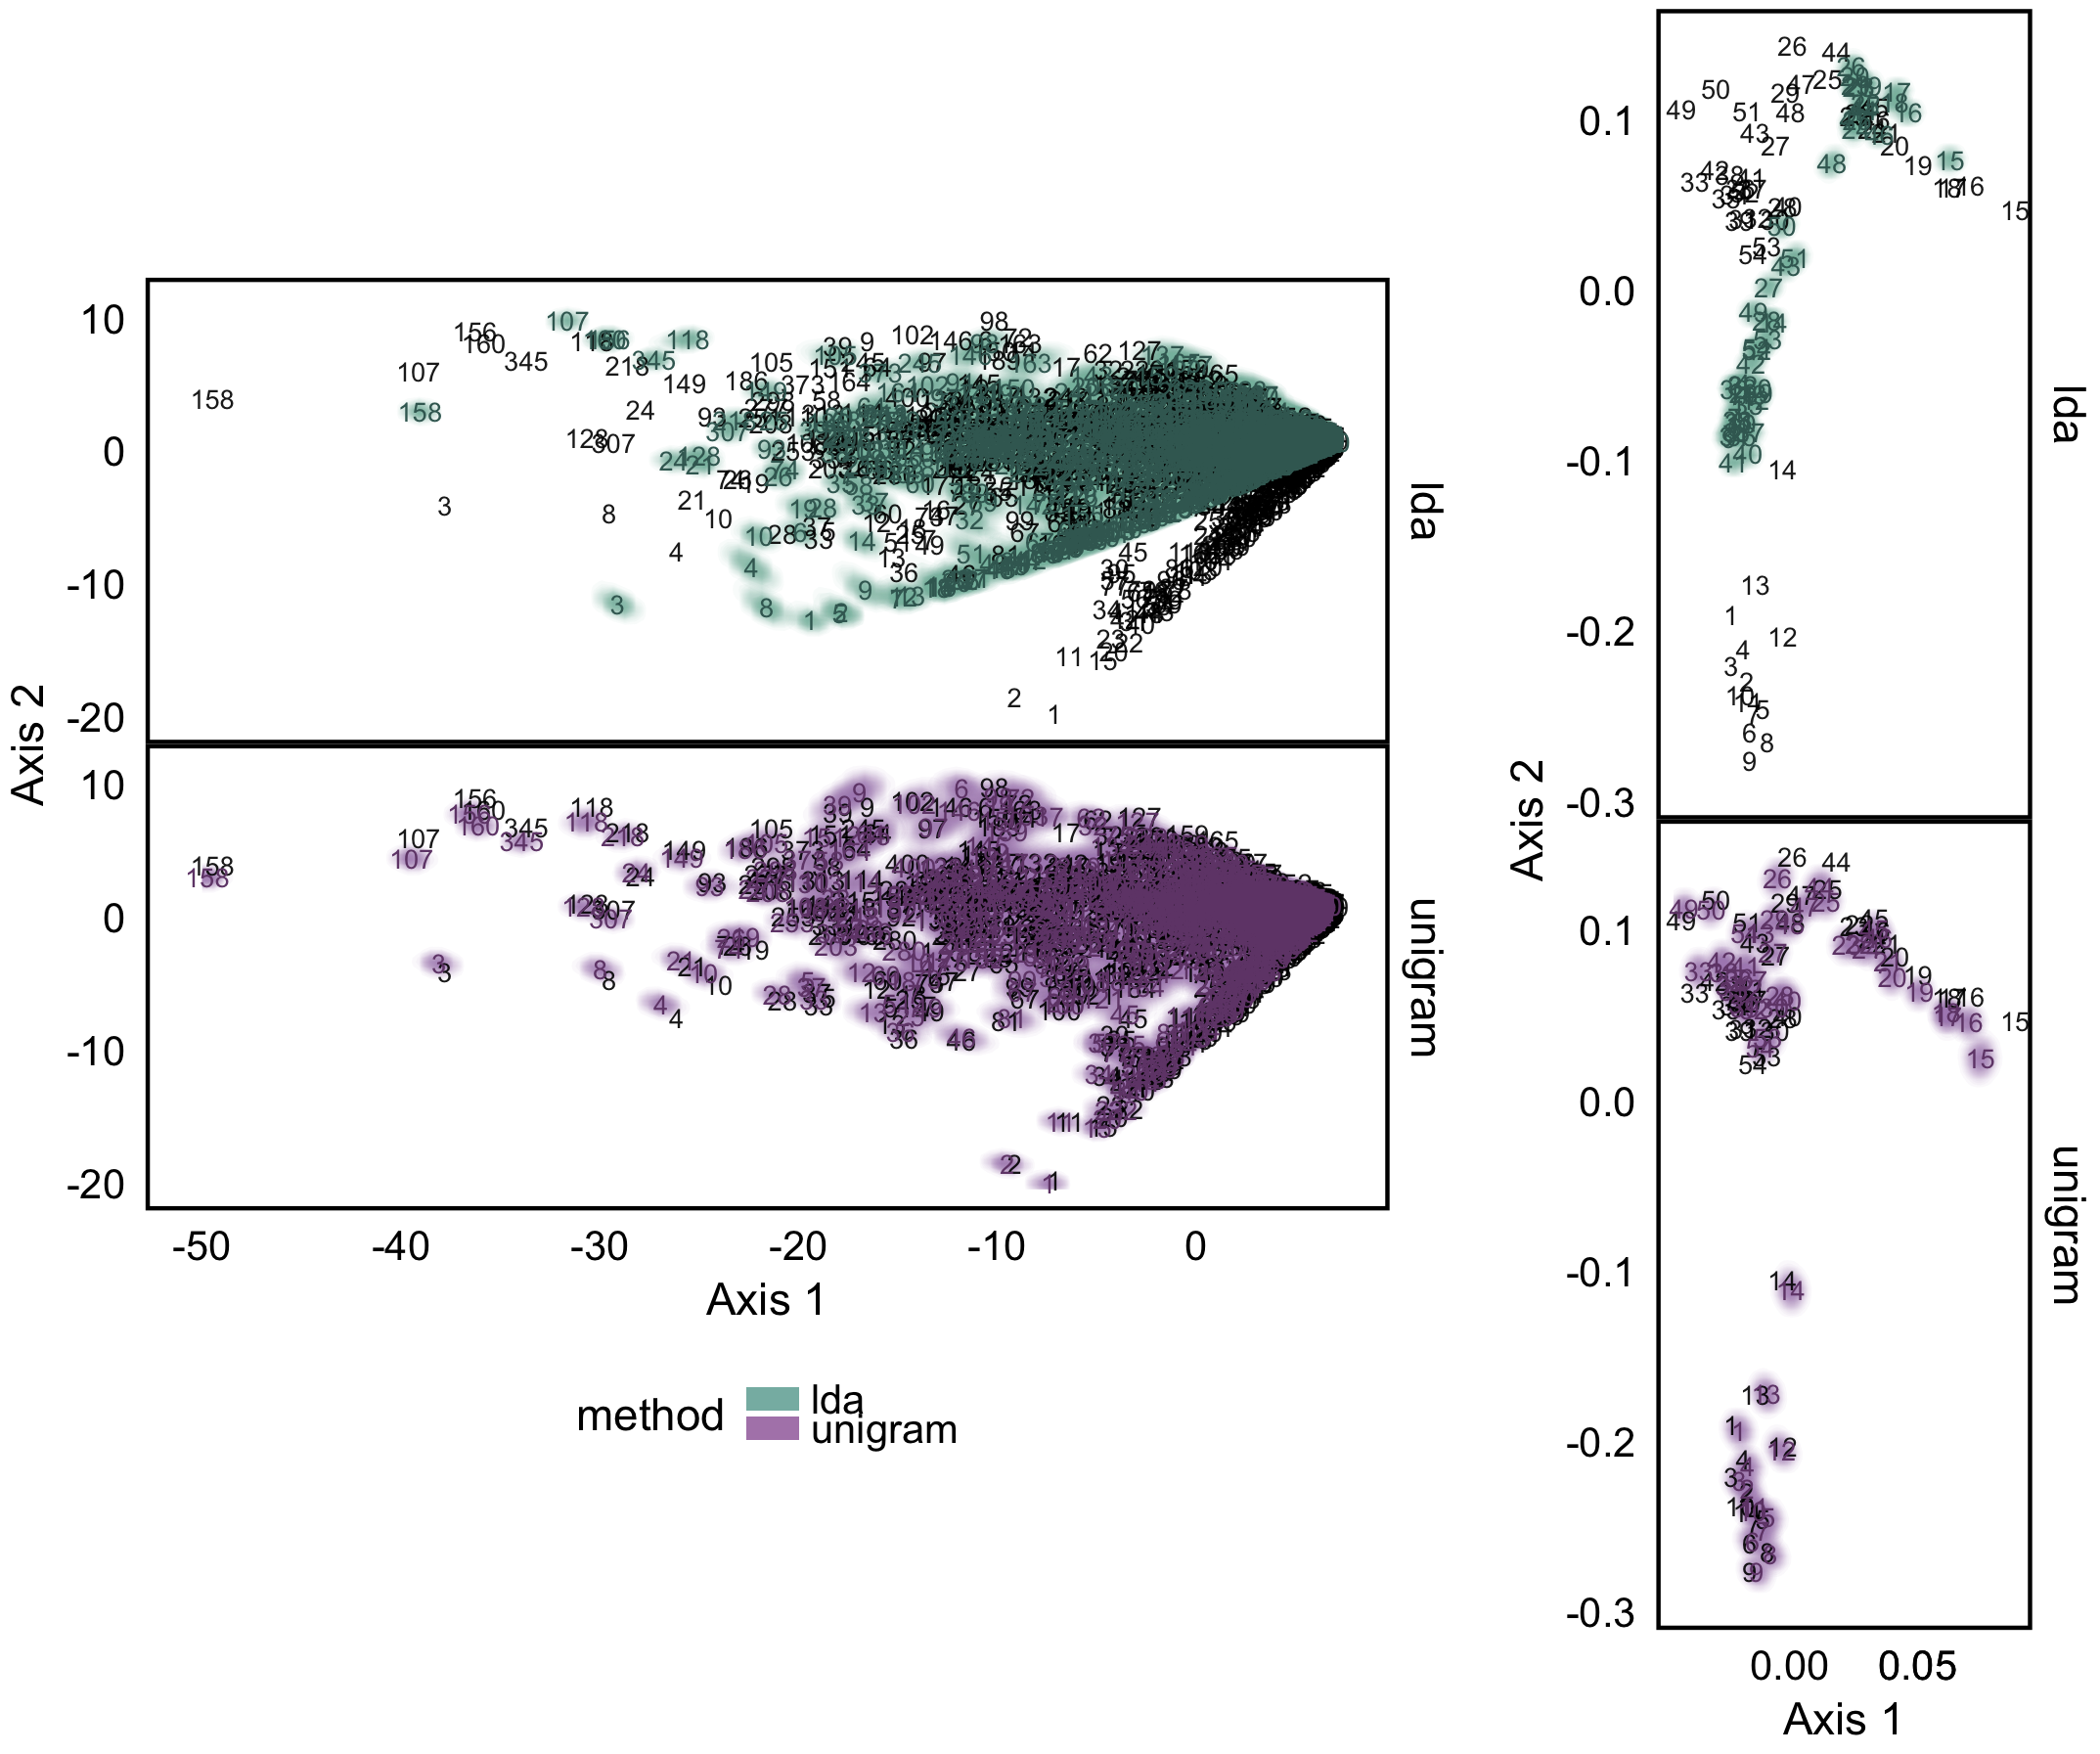
Model Criticism
We can perform PCA on the posterior predictive samples
Loadings (species) are given on the left, while scores (samples) are given on the right
Black text are observed scores / loadings, clouds come from posterior predictive samples
Scores and loadings have been aligned using a procrustes rotation

Slide 40
Conclusion
Microbiome studies are a source of richly structured, high-dimensional data
Exploratory data visualization and probabilistic modeling can help develop interpretable representations of microbiome data
We have not addressed more inferential questions, or begun to quantify how far any particular analysis might be from “optimal”
However, by providing workflows and releasing code and data, we are bringing the field closer to a “common task framework”
treelapse: https://krisrs1128.github.io/treelapse/
Latent variable modeling: https://github.com/krisrs1128/microbiome_plvm

Slide 41
References
Becker, Richard A., and William S. Cleveland. "Brushing scatterplots." Technometrics 29, no. 2 (1987): 127-142.
Blei, David M., Andrew Y. Ng, and Michael I. Jordan. "Latent dirichlet allocation." Journal of machine Learning research 3, no. Jan (2003): 993-1022.
Blei, David M., and John D. Lafferty. "Dynamic topic models." In Proceedings of the 23rd international conference on Machine learning, pp. 113-120. ACM, 2006.
Buja, Andreas, Dianne Cook, and Deborah F. Swayne. "Interactive high-dimensional data visualization." Journal of computational and graphical statistics 5, no. 1 (1996): 78-99.
Callahan, Ben J., Kris Sankaran, Julia A. Fukuyama, Paul J. McMurdie, and Susan P. Holmes. "Bioconductor workflow for microbiome data analysis: from raw reads to community analyses." F1000Research 5 (2016).
Canny, John. "GaP: a factor model for discrete data." In Proceedings of the 27th annual international ACM SIGIR conference on Research and development in information retrieval, pp. 122-129. ACM, 2004.
Dethlefsen, Les, and David A. Relman. "Incomplete recovery and individualized responses of the human distal gut microbiota to repeated antibiotic perturbation." Proceedings of the National Academy of Sciences 108, no. Supplement 1 (2011): 4554-4561.

Slide 42
Fukuyama, Julia, Laurie Rumker, Kris Sankaran, Pratheepa Jeganathan, Les Dethlefsen, David A. Relman, and Susan P. Holmes. "Multidomain analyses of a longitudinal human microbiome intestinal cleanout perturbation experiment." PLoS Computational Biology 13, no. 8 (2017): e1005706.
Hu, James X., Hongyu Zhao, and Harrison H. Zhou. "False discovery rate control with groups." Journal of the American Statistical Association 105, no. 491 (2010): 1215-1227.
Pritchard, Jonathan K., Matthew Stephens, and Peter Donnelly. "Inference of population structure using multilocus genotype data." Genetics 155, no. 2 (2000): 945-959.
Schloss, Patrick D., and Jo Handelsman. "The last word: books as a statistical metaphor for microbial communities." Annu. Rev. Microbiol. 61 (2007): 23-34.
Voigt, Robert. "An extended scatterplot matrix and case studies in information visualization. published as diplomarbeit." (2002).
Yekutieli, Daniel. "Hierarchical false discovery rate–controlling methodology." Journal of the American Statistical Association103, no. 481 (2008): 309-316.

Slide 43
